Slide 1





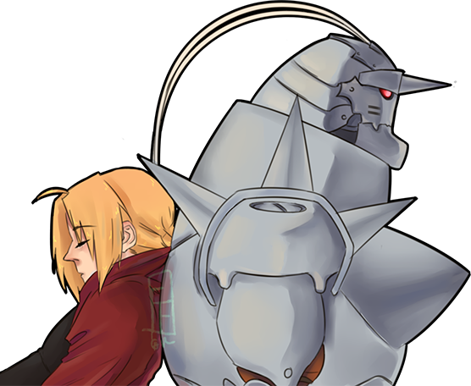

r/Naruto vs. r/anime
A presentation on classification models using
Early 21st century machine learning techniques
Presented by: Daniel wang (of the Neo-earth research council)

Slide 2
3023 Mars Conference
on
Pre-World War 3 Humanoid Anthropology
WELCOME

Slide 3

Presentation Outline
3. Discussion of methods
2. Background info
4. Results & Findings
21st Century Machine Learning & Classification Methods
What is anime? Who is Naruto?
Classification Model Results
1. Problem Statement
5. conclusions
Recovered Pre-WWIII data discs of popular 21st century website ‘reddit’
Evaluating Findings

Slide 4




Problem Statement
Recovered 21st century artifacts
During a recent expedition to the ruins of alpha-Earth, an exploration team recovered a semi-operable server containing data from the popular 21st century website Reddit.
21st century data science techniques
Additionally, the team discovered a manual on early 21st century data science techniques for classification and machine learning.
Using 21st century methods to analyze
21st century data
We explored the use of natural language processing and several classification algorithms to differentiate between posts from r/anime vs. those from r/Naruto.

Slide 5

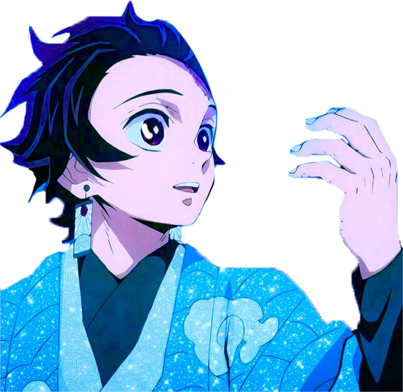
ANIME
Anime is hand-drawn and computer-generated animation originating from Japan. Outside of Japan and in English, anime refers to Japanese animation, and refers specifically to animation produced in Japan. However, in Japan and in Japanese, anime (a term derived from a shortening of the English word animation) describes all animated works, regardless of style or origin. Animation produced outside of Japan with similar style to Japanese animation is commonly referred to as anime-influenced animation.

Slide 6

Naruto was an anime/manga series initially airing from 2002-2017*. The series’ popularity coincided with (& helped fuel) an explosion in popularity of anime/manga outside of Japan.
It’s effects on the genre were significant enough that it can be considered the quintessential shounen** series of the early 21st century, upon which many subsequent anime tropes were based.
* Naruto (2002–07)
Naruto: Shippuden (2007–17)
** shounen = "boys' comics", targeting an audience of adolescent boys

Slide 7
Methods
Data scraping via API
Tokenizing
Lemmatizing
Stop Words
n-word grams
Count vectorization
Grid Search
Confusion Matrices

Slide 8
Classification Methods
Naïve Bayes
NB w/TfidfVectorizer
Random Forest
K Nearest Neighbors
(Using Standard CountVectorizer)
(Term Frequency-Inverse
Document Frequency Vectorizer)

Slide 9
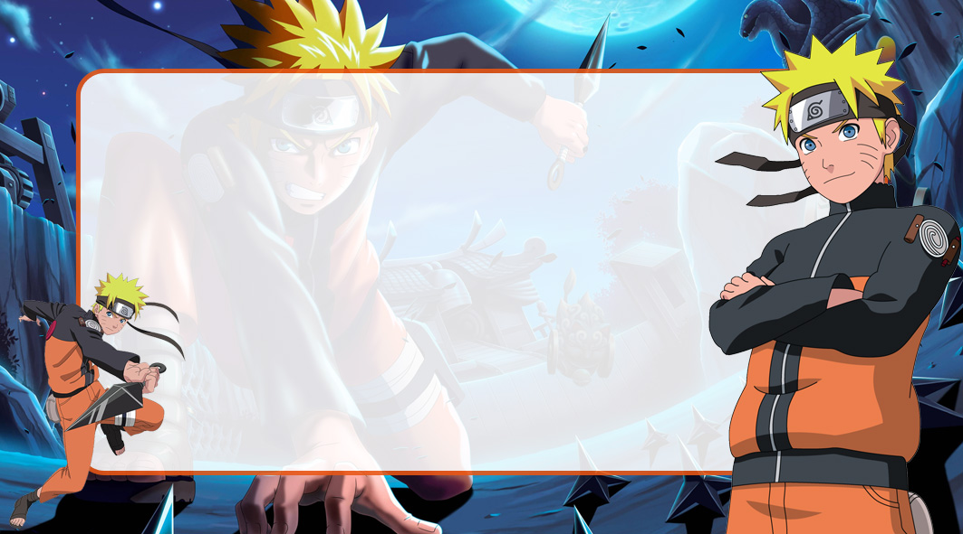
Baseline
Dataset:
4887 posts from r/anime (50.8%)
4734 posts from r/Naruto (49.2%)
Baseline prediction accuracy: 50.8%

Slide 10
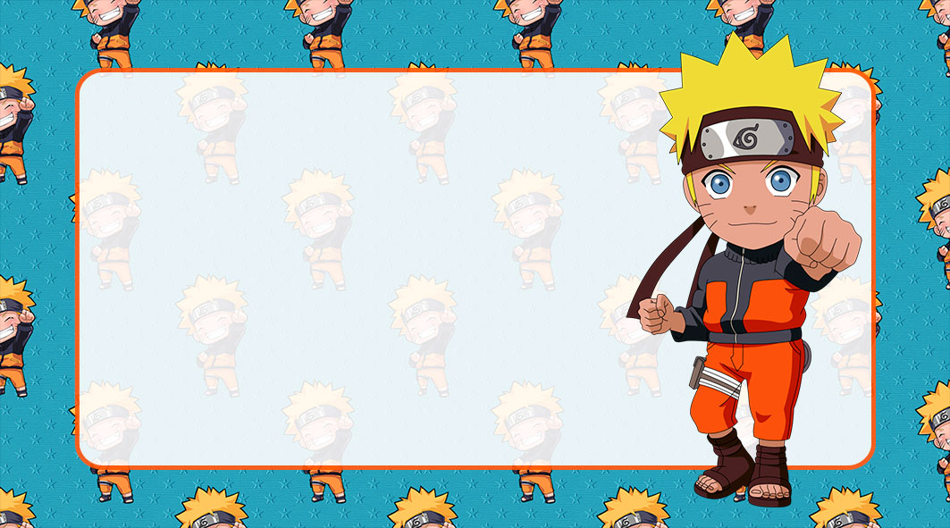
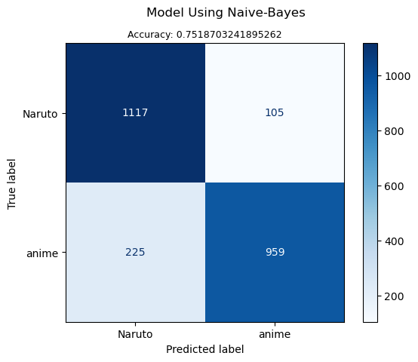
Naïve Bayes (w/ Standard CountVectorizer)

Slide 11

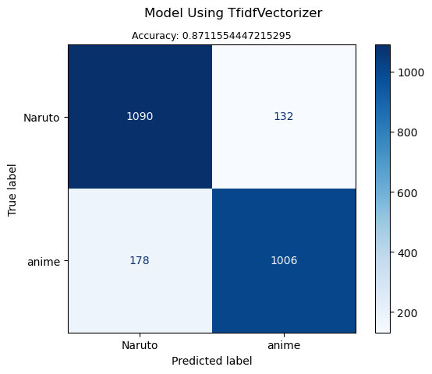
NB w/ TfidfVectorizer

Slide 12
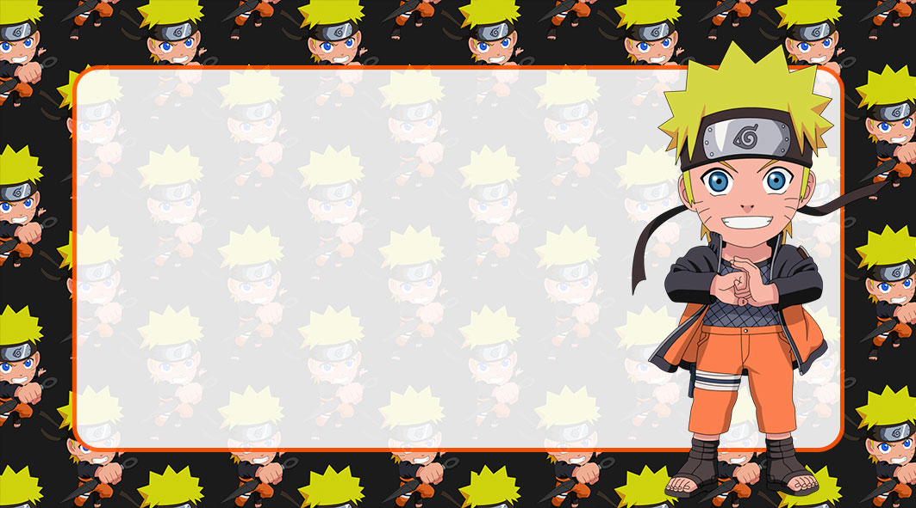
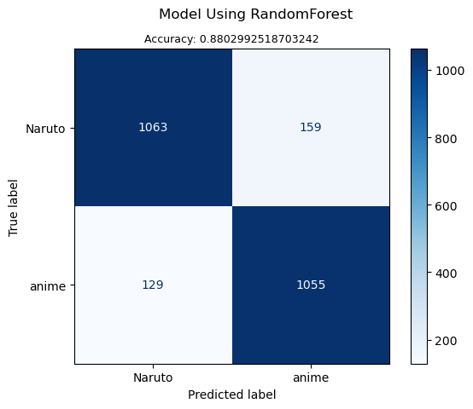
Random Forest

Slide 13
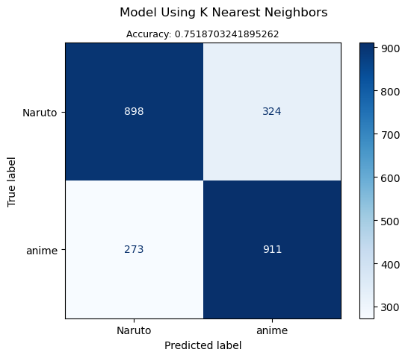
K Nearest Neighbors

Slide 14
Final Rankings
Rank Algorithm Accuracy
Random Forest 88.03%
TfidfVectorizer 87.12%
Naive Bayes 86.28%
K Nearest Neighbors 75.19%

Slide 15
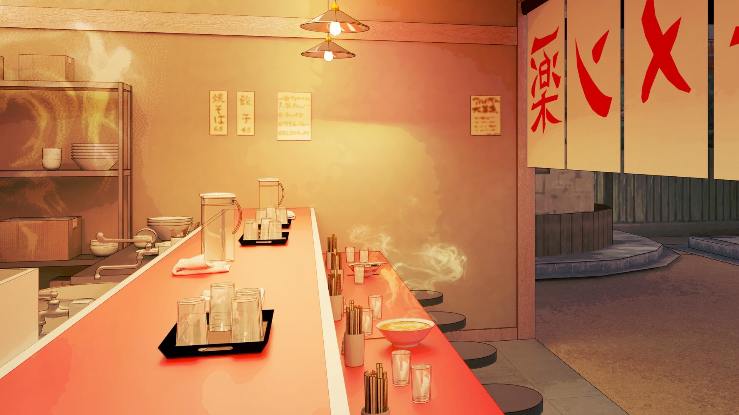
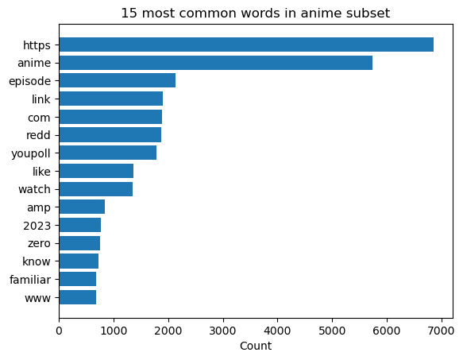
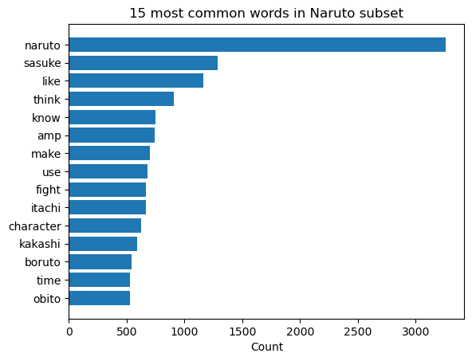
Most common words

Slide 16
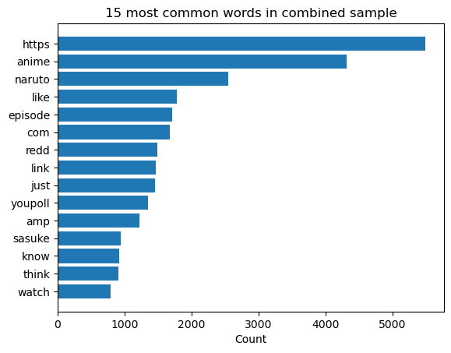
Most common words

Slide 17
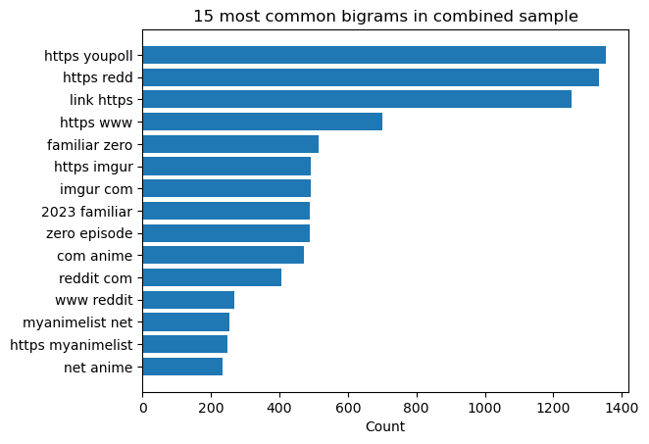
Most common bigrams

Slide 18
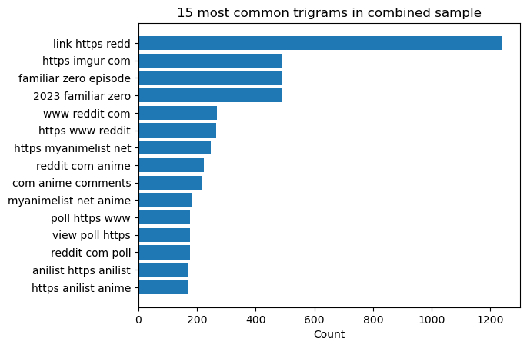
Most common trigrams

Slide 19

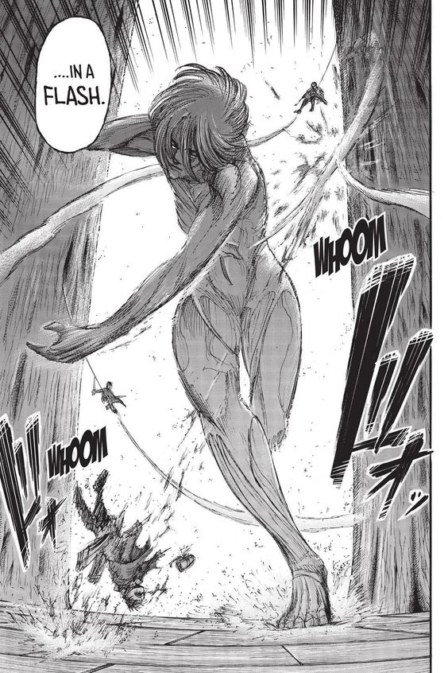
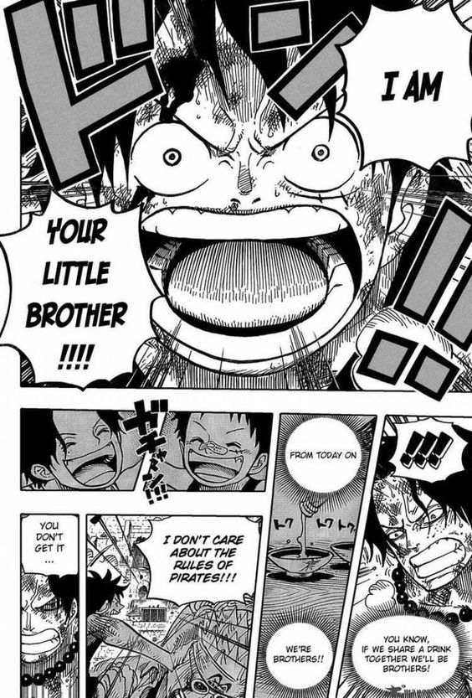
Conclusions
The Random Forest (with unlimited depth, single-word n-grams only, and without using stop words) narrowly outperformed its competitors with an accuracy of 88.03%.
Based on our findings, all techniques explored yielded better classification results than our baseline. The text discussions from r/anime CAN be reliably differentiated from those of r/Naruto
The results of our study provide an interesting window into early 21st century alpha-Earth pop culture as well as the contemporary data science techniques of the era.

Slide 20



THANK YOU!
Questions/comments?

Slide 21
credits
Data Scraping:
Pushshift Reddit API
Main Slides Template:
Slide Chef
Additonal Graphics:
Drevio [1]
imagemlegal.com.br [1, 2, 3]
fazendoanossafesta.com.br [1]

